Slide 1

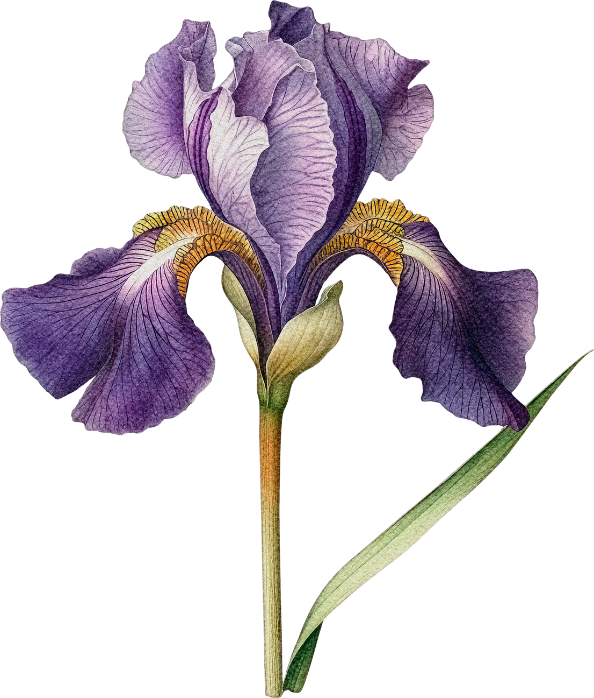

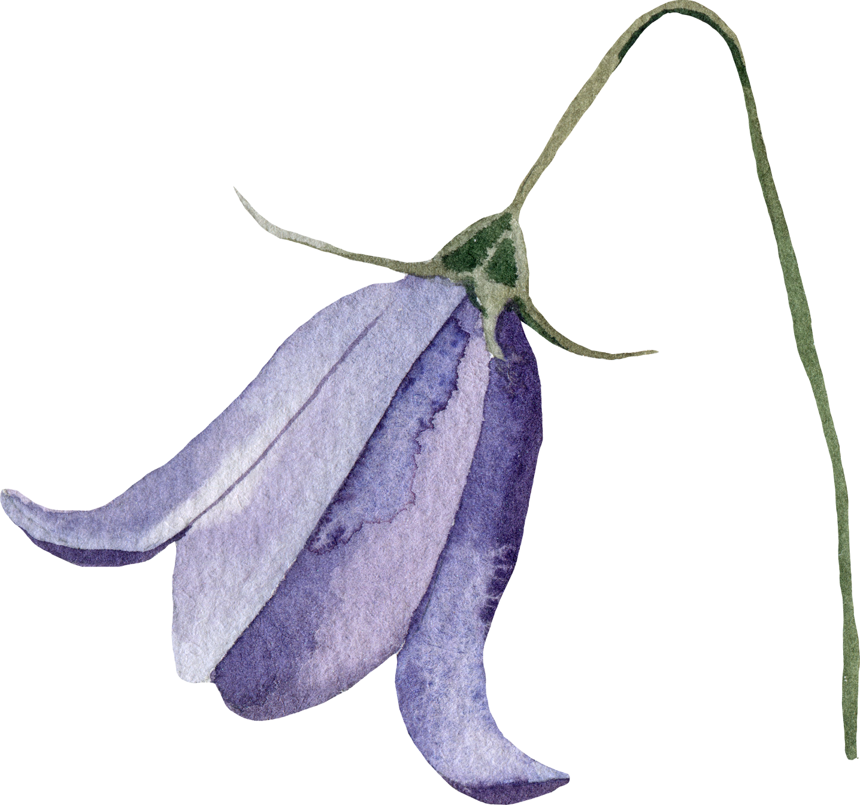

IRIS FLOWER CLASSIFICATION
USING DECISION TREE
Tasya Dwini Novianti

Slide 2

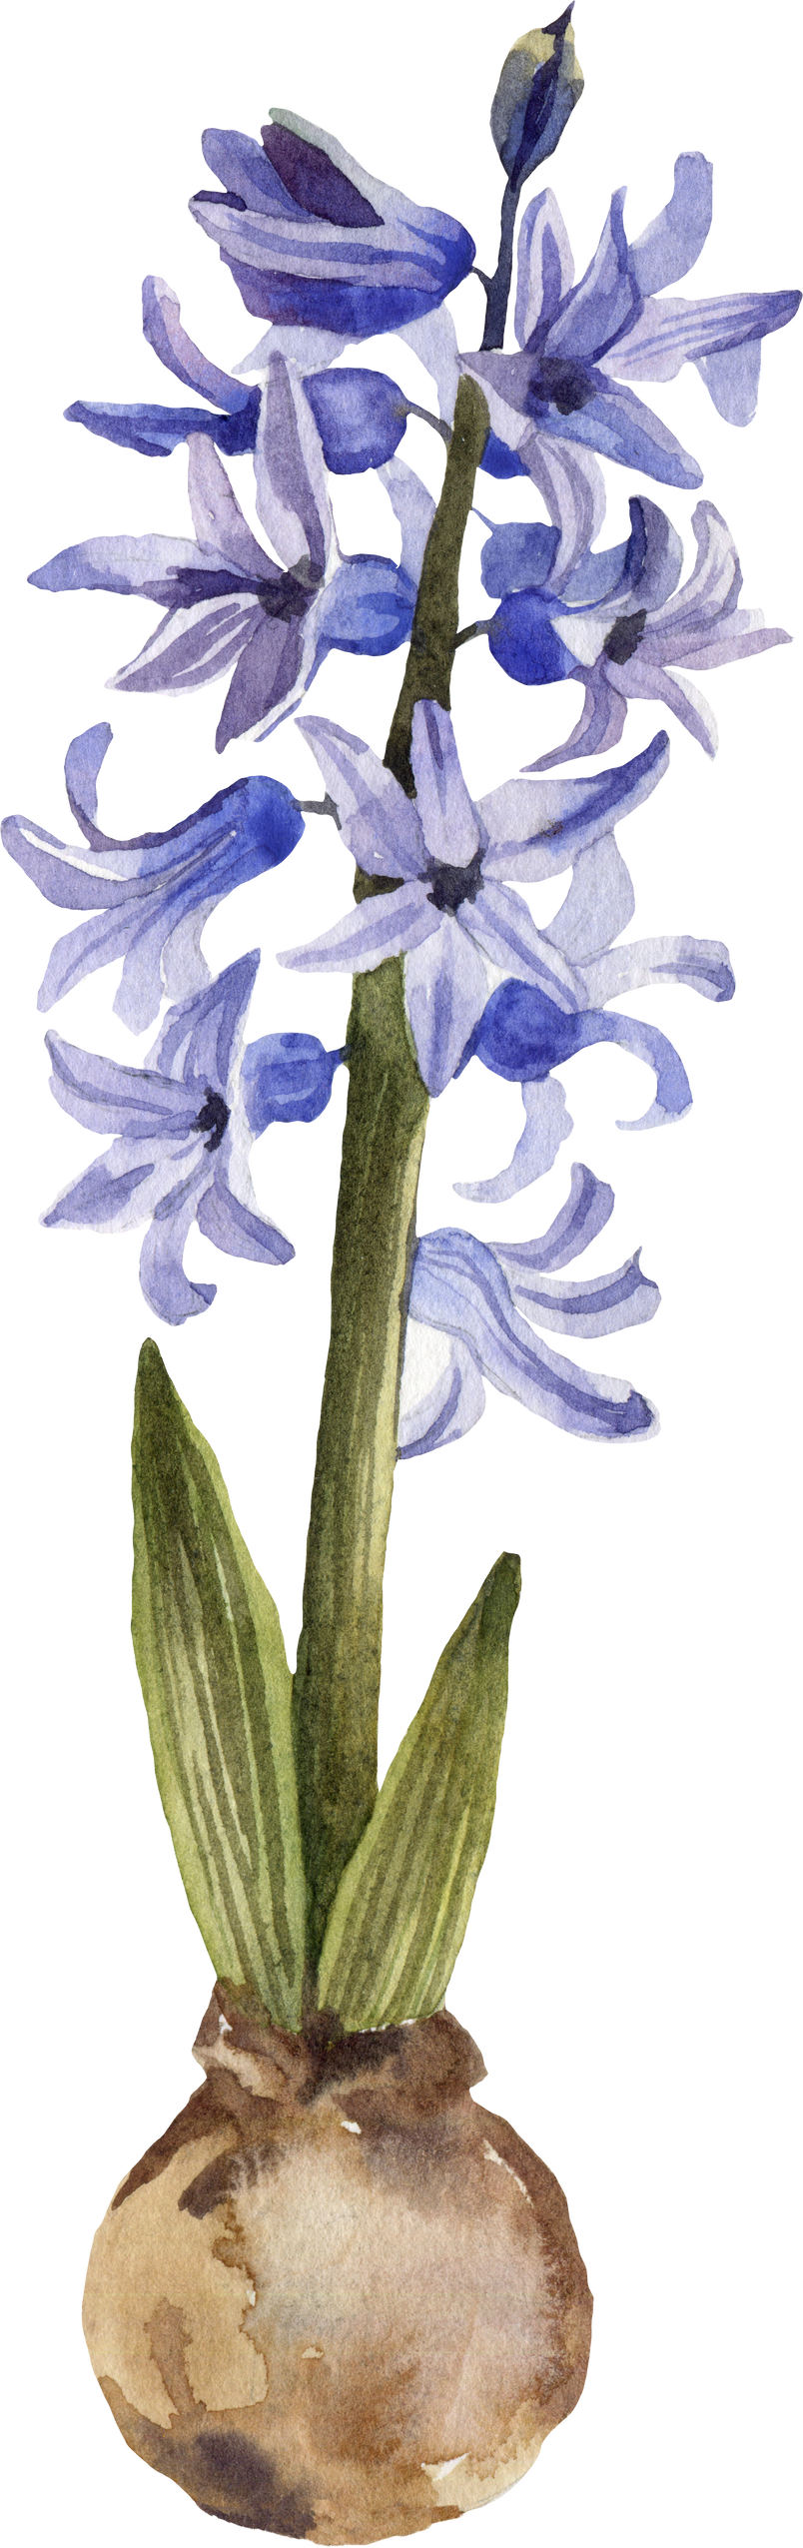




DATASET
A small classic dataset from Fisher, 1936. One of the earliest known datasets used for evaluating classification methods. The data set contains 3 classes of 50 instances each, where each class refers to a type of iris plant. One class is linearly separable from the other 2; the latter are not linearly separable from each other.
TOOLS & LIBRARY

Slide 3
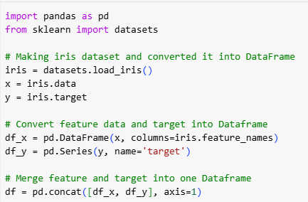
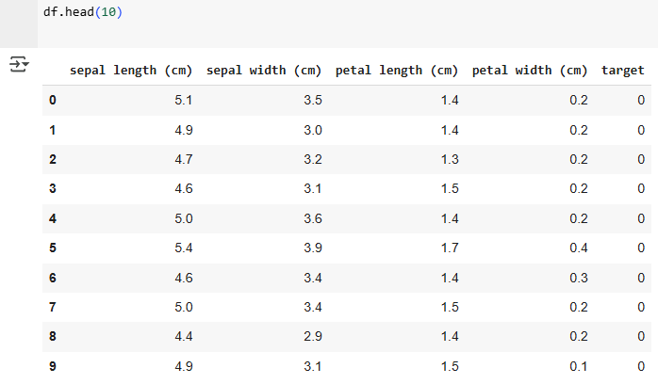
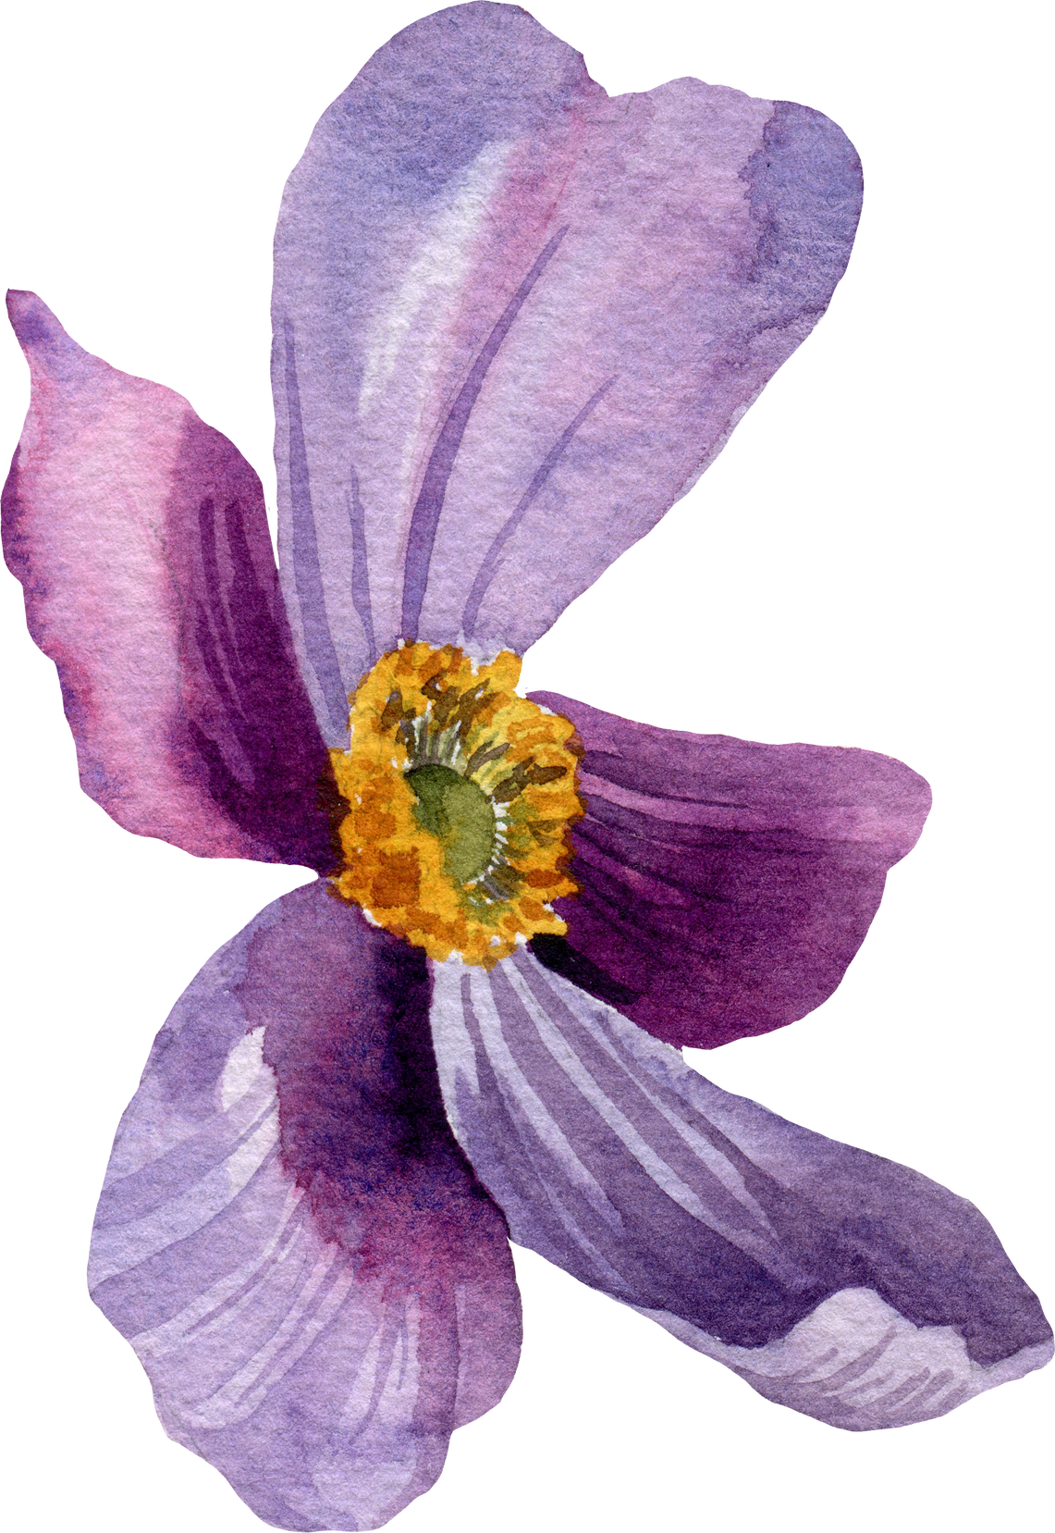
IMPORT & READ DATA
Before working with the dataset, we need to import the Pandas library. Next, we import the Iris dataset using Scikit-Learn and merge the feature data and target into a single DataFrame called df. We can view the DataFrame using the df.head() command.

Slide 4
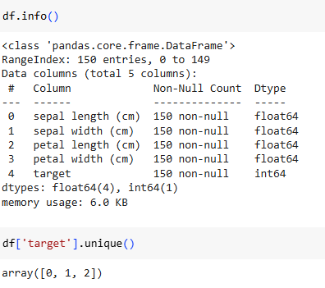
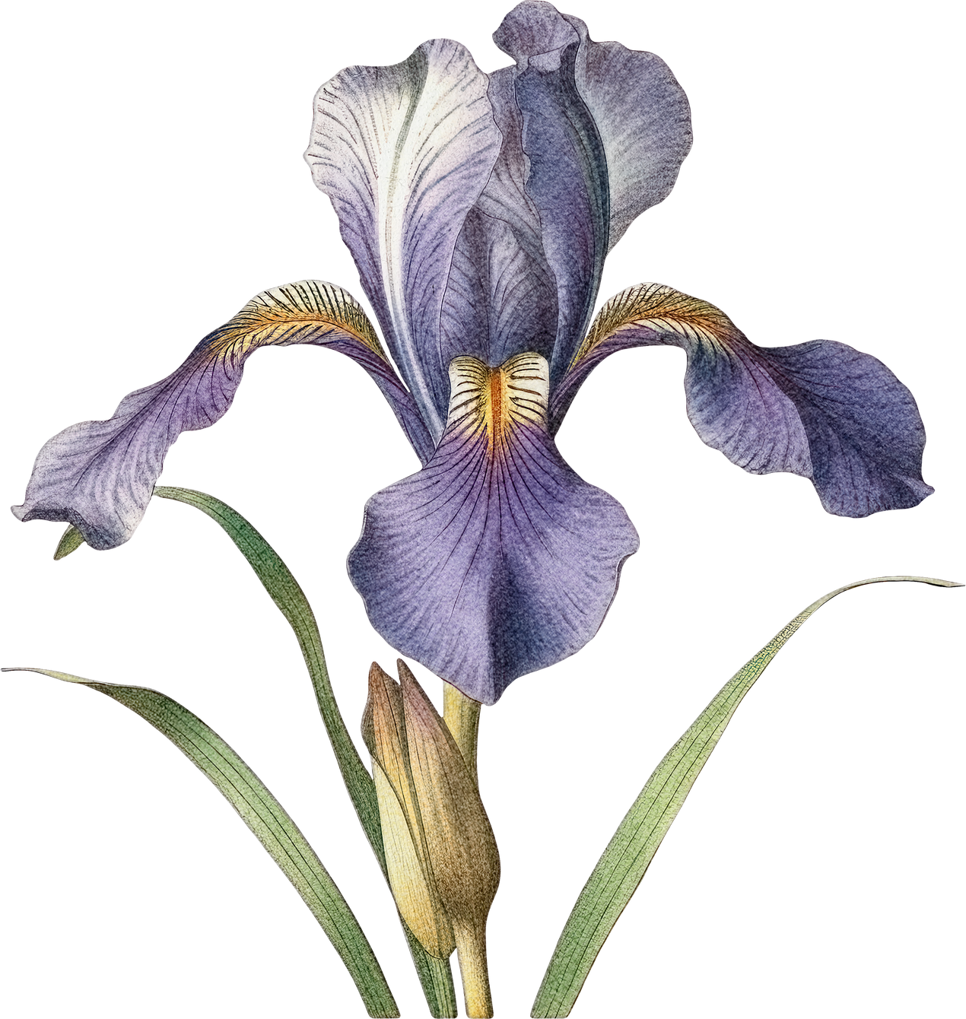
DATA INFORMATION
The df.info() function provides information about our dataset. This dataset contains 150 rows and 5 columns. Four of the columns contain float values, while one column, target, contains integer values.
The target column has 3 unique values, representing the different species of the Iris flower.
0 = Setosa
1 = Versicolor
2 = Virginica

Slide 5
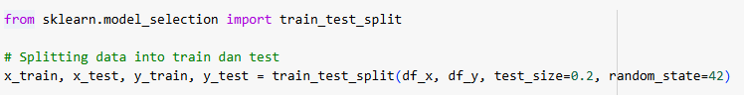
SPLIT DATA
The next step is splitting the data into data train and data test
x: Contains the independent variables (sepal length, petal length, etc.).
y: Contains the dependent variable (flower species).
test_size=0.2 → 20% of the data is used for testing, and 80% for training.
random_state=42 → Ensures consistent results when running the code multiple times.

Slide 6
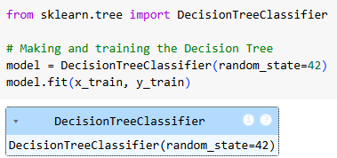
TRAIN THE MODEL
Training a Decision Tree classifier is a crucial step in building a machine learning model. This process involves learning patterns from the training data to make predictions.

Slide 7
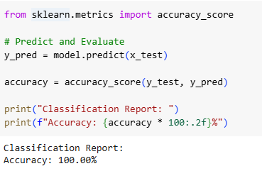
PREDICT AND EVALUATE
The Decision Tree classifier provides high accuracy on the Iris dataset. This indicates that the model effectively classifies the three Iris species (Setosa, Versicolor, and Virginica).

Slide 8
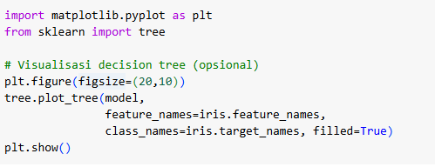
DATA VISUALIZATION
Using Matplotlib, we can visualize the Decision Tree as a diagram that illustrates how the classifier splits data at different decision nodes, providing clear and interpretable decision rules based on feature values, thresholds, and class distributions.

Slide 9
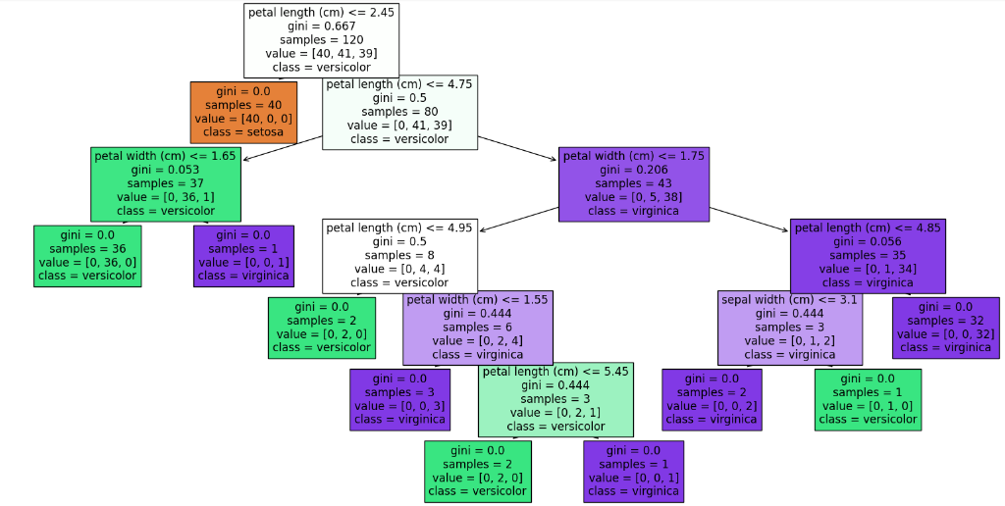
DECISION TREE

Slide 10
CONCLUSION
By using a Decision Tree as a classifier for the Iris dataset, we achieve 100% accuracy, indicating that the model effectively classifies the three Iris species (Setosa, Versicolor, and Virginica). Additionally, the visualization provides clear and interpretable decision rules based on feature values. However, for larger and more complex datasets, pruning or ensemble techniques may be necessary to improve generalization.

Slide 11
THANK YOU

